Slide 1
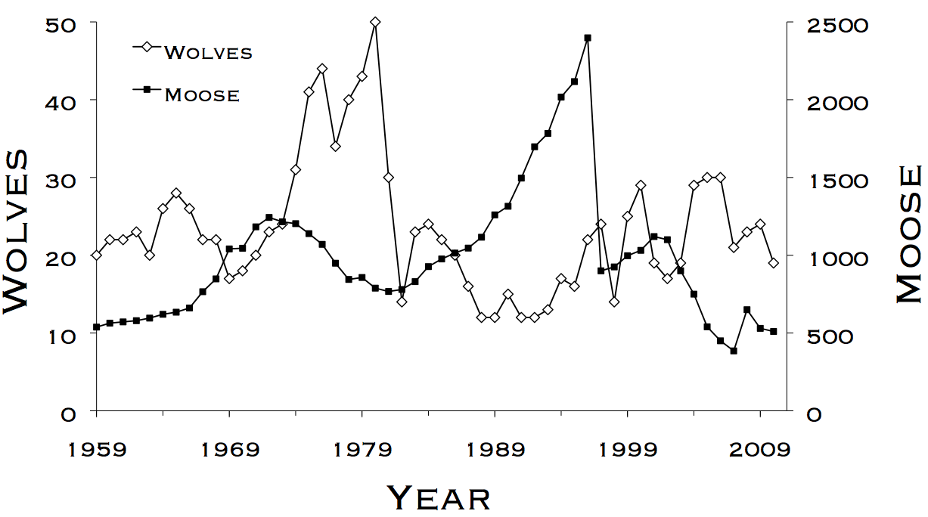
Lab 6 – Known Fate 1
WLE 411, Week 10

Slide 2
Course review
Only four labs left (including this one)
Good time to check your grades
If you have unsubmitted lab assignments, consider submitting them as revisions
No lab next week

Slide 3


Last week- CJS models
$$Φ$$
$$p$$
Apparent survival between intervals
Detection/recapture probability in an interval

Slide 4

This week- Known Fate models
$$S$$
Survival within each interval

Slide 5
Features of Known Fate models
Detection presumed to be perfect
Animals can be found dead
Examples:
Radio-tracked deer
Bird nests

Slide 6
Differences in capture history format
CJS
Rows represent individuals
1 0 1 1 0 1 0 0
1: Observed
0: Unobserved
Columns represent capture intervals
Known Fate
Rows represent individuals
10 10 11 00
10: Alive during the interval
11: Died during the interval
00: Not tracked during the interval
(censored)
Clusters of two represent capture intervals

Slide 7


Linear regression review
$$y=mx+b$$
$$γ=β_{1}x+β_{0}$$

Slide 8
Response (dependent) variable
$$y=mx+b$$
$$γ=β_{1}x+β_{0}$$
Predictor (independent) variable

Slide 9
Slope
$$y=mx+b$$
$$γ=β_{1}x+β_{0}$$
Y-intercept

Slide 10


How do we add parameters to describe S?
$$γ=β_{1}x+β_{0}$$
$$logit\left(S\right)=β_{Sex}∗Sex+β_{0}$$
Interval survival, transformed by a link function

Slide 11
How do we add parameters to describe S?
$$γ=β_{1}x+β_{0}$$
$$logit\left(S\right)=β_{Sex}∗Sex+β_{0}$$
Intercept (baseline survival)

Slide 12
How do we add parameters to describe S?
$$γ=β_{1}x+β_{0}$$
$$logit\left(S\right)=β_{Sex}∗Sex+β_{0}$$
Sex (categorical variables expressed as 0s and 1s)

Slide 13
How do we add parameters to describe S?
$$γ=β_{1}x+β_{0}$$
$$logit\left(S\right)=β_{Sex}∗Sex+β_{0}$$
Difference in survival between sexes

Slide 14


Example survival calculation
Females (represented as 0):
$${logit(S}_{female})=β_{Sex}∗0+β_{0}$$
$${logit(S}_{female})=β_{0}$$
Males (represented as 1):
$${logit(S}_{male})=β_{Sex}∗1+β_{0}$$
$${logit(S}_{male})={β_{Sex}+β}_{0}$$

Slide 15
General advice for this lab
Link functions are a common sticking point
Converts results from a linear framework (y = mx + b) into survival probabilities
Take your time on the conceptual background
Dummy variables, multiple groups, etc.

